Slide 1
REAL WORLD CRIME DATA ANALYSIS AND VISUALIZATION USING TABLEAU
GUIDE : Mr. Khasimpeera Mohammed
Chukka Dinesh Raja
20KT1A0518

Slide 2
CONTENTS:
Abstract
Existing System
Drawbacks of Existing System
Proposed System
Advantages of Proposed System
Literature Review
Software & Hardware Requirements
Architecture Design
System Design
Conclusion
Future Enhancement
Reference Papers / Bibliography

Slide 3
ABSTRACT
Crime is a longstanding societal issue that poses significant challenges to public safety and law enforcement agencies worldwide. This project delves into the realm of crime data analysis, leveraging the robust capabilities of Tableau, a powerful data visualization tool, to dissect real-time crime data sourced from various governmental databases in India. Kidnap cases, murder incidents, and instances of property stolen and recovered serve as focal points for this analysis, each shedding light on different facets of criminal activity
The scope of this project extends beyond mere data aggregation and visualization, aiming to provide a holistic view of crime dynamics in India. By scrutinizing trends over time and dissecting crime patterns according to gender, age, and geographical location, the project aims to unravel underlying factors driving variations in crime rates and outcomes. Furthermore, the analysis delves into exploratory data analysis (EDA), unearthing hidden insights and anomalies within the datasets. Through a comprehensive examination of crime data, this project seeks to equip stakeholders with evidence-based insights

Slide 4
EXISTING SYSTEM
Currently, many agencies rely on manual data entry, basic statistical analysis, and static reports, which often result in time-consuming processes and fail to provide real-time insights into crime trends and patterns. Moreover, the sheer volume and complexity of crime data pose significant challenges in identifying actionable insights that can inform strategic decision-making and resource allocation.
Furthermore, existing crime data analysis systems may lack integration capabilities, making it difficult to analyze diverse datasets related to different types of crimes comprehensively. This fragmentation hampers the ability to identify correlations and patterns across various crime categories, hindering effective crime prevention and investigation efforts.

Slide 5
DRAWBACKS OF EXISTING SYSTEM
Manual Data Entry: Relying on manual data entry introduces the risk of human error, leading to inaccuracies in the recorded data. Additionally, it is time-consuming and labor-intensive, diverting resources from more critical tasks.
Basic Statistical Analysis: Basic statistical analysis techniques may overlook nuanced patterns or correlations present in the data. Without advanced analytical methods, such as machine learning algorithms or predictive modeling, valuable insights may remain undiscovered.
Static Reports: Static reports provide a snapshot of crime data at a particular point in time, but they lack the ability to adapt to changing trends or emerging patterns. As a result, decision-makers may not have access to up-to-date information necessary for timely interventions.
Limited Real-time Insights: Traditional analysis methods often do not offer real-time insights into crime trends and patterns. Without access to timely data, law enforcement agencies may struggle to respond promptly to emerging threats or allocate resources efficiently.
Volume and Complexity of Data: The sheer volume and complexity of crime data make it challenging to process and analyze manually. As datasets grow larger and more diverse, traditional analytical approaches may struggle to extract meaningful insights from the data deluge.

Slide 6
PROPOSED SYSTEM
In this proposed system will make the use of tableau, to conduct a comprehensive analysis of crime data. The system will consist of Several key components and functionalities aimed at achieving the project objectives outlined the problem statements which ultimately serves the requirements
To develop Crime Data analysis system, we will use three steps:
• Data Integration and Aggregation
• Data Visualization and Analysis
• Exploring Data Analysis (EDA)

Slide 7
ADVANTAGES OF PROPOSED SYSTEM
Enhanced efficiency through automation: By automating tasks, the system will save time and effort.
Improved data integration and real-time updates: Better integration of data sources and real-time updates will provide more accurate and up-to-date information
Reduced dependency on technical expertise: Simplified system management will reduce the need for specialized technical skills.
Strengthened data security measures: Enhanced security measures will protect sensitive data from unauthorized access.
Advanced predictive analytics for informed decision-making: The system will use data analysis to predict future trends and outcomes, enabling smarter decision-making.

Slide 8
Literature Review
Title : Design and analysis of machine learning algorithms for the reduction of crime rates in India.
https://www.sciencedirect.com/science/article/pii/S1877050920313417
By the means of machine learning techniques, determining the pattern relations among huge set of data has become easier. This research mainly depends on providing a prediction on crime type that might occur based on the location where it has already taken place. Machine learning has been used to develop a model by the use of training data set that have gone through the process of data cleaning and transformation. Analysis of data set along with its characteristics can be implemented with the aid of data visualization. The various factors are being identified and captured. Risk factors are being identified and predictive measures are designed which help in keeping society safe. Various clustering algorithms, optimization algorithms and statistical analysis has been done in this work.

Slide 9
Literature Review
Title: Crime analysis using dbscan algorithm
https://ieeexplore.ieee.org/abstract/document/9544719
Abstract:
In this paper a user-friendly web application has been proposed that investigates criminal data using data analysis and data visualization methods. Using this system, the user can understand the crime patterns, crime trends, identify the criminal hotspots by observing the results from the data visualization methods. Density based Spatial Clustering of Applications with Noise (DBSCAN) algorithms has been used to cluster the crimes according to the location. The Crime Analysis Web Application is developed using the open-source framework Streamlit and Google Cloud Platform's (GCP) BigQuery engine.

Slide 10
Literature Review
Title: South Africa crime visualization, trends analysis, and prediction using machine learning linear regression technique
https://www.hindawi.com/journals/acisc/2021/5537902/
Abstract:
South Africa has been classified as one of the most homicidal, violent, and dangerous places across the globe. Many traditional approaches to data analysis in crime-related studies have been done in South Africa, but the machine learning approach has not been adequately considered.
This research work aimed at offering a solution to the problem by building a model that can predict crime. The machine learning approach shall be used to extract useful information from South Africa's nine provinces' crime data. A crime prediction system that can analyze and predict crime is proposed. To accomplish this, South Africa crime data on 27 crime categories were obtained from the popular data repository “Kaggle.” Diverse data analytics steps were applied to preprocess the datasets, and a machine learning algorithm (linear regression) was used to build a predictive model to analyze data and predict future crime. The appropriate authorities and security agencies in South Africa can have insight into the crime trends and alleviate them to encourage the foreign stakeholders to continue their businesses.

Slide 11
Literature Review
Title: Using machine learning algorithms to analyze crime data
https://www.researchgate.net/profile/Natarajan-Meghanathan/publication/275220711_Using_Machine_Learning_Algorithms_to_Analyze_Crime_Data/links/571dc8ae08ae408367be5de8/Using-Machine-Learning-Algorithms-to-Analyze-Crime-Data.pdf
Abstract:
Data mining and machine learning have become a vital part of crime detection and prevention. In this
research, we use WEKA, an open source data mining software, to conduct a comparative study between the
violent crime patterns from the Communities and Crime Unnormalized Dataset provided by the University
of California-Irvine repository and actual crime statistical data for the state of Mississippi that has been
provided by neighborhoodscout.com. We implemented the Linear Regression, Additive Regression, and
Decision Stump algorithms using the same finite set of features, on the Communities and Crime Dataset.
Overall, the linear regression algorithm performed the best among the three selected algorithms. The scope
of this project is to prove how effective and accurate the machine learning algorithms used in data mining
analysis can be at predicting violent crime patterns.

Slide 12
S.NO | Author Name | Title of the paper | Algorithms Used
1 | D. Mungekar | Design and Analysis of Machine Learning Algorithms for the reduction of crime rates in India | Levenberg Algorithm, Scaled Algorithm
2 | Ibidun Christiana Obagbuwa | Crime analysis using DBSCAN Algorithm | DBSCAN
3 | McClendon | South Africa Crime Visualization, Trends Analysis, and Prediction Using Machine Learning Linear Regression Technique | Linear Regression
4 | Shraddha Ramdas Bandekar | Using Machine Learning Algorithms To Analyze Crime Data | Linear Regression Model, Addictive Regression Model, Decision Stump Model.

Slide 13
Software Requirements
Domain : Data analytics
Software Tool : Tableau Professional Software
Operating System : Windows 10 or higher
Hardware Requirements
RAM (min 8GB)
Personal Computer/Laptop
Intel Core i5 Processor

Slide 14
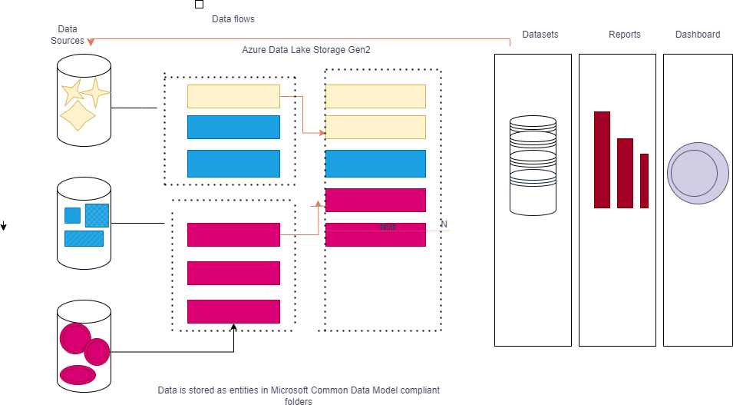
ARCHITECTURE DESIGN

Slide 15
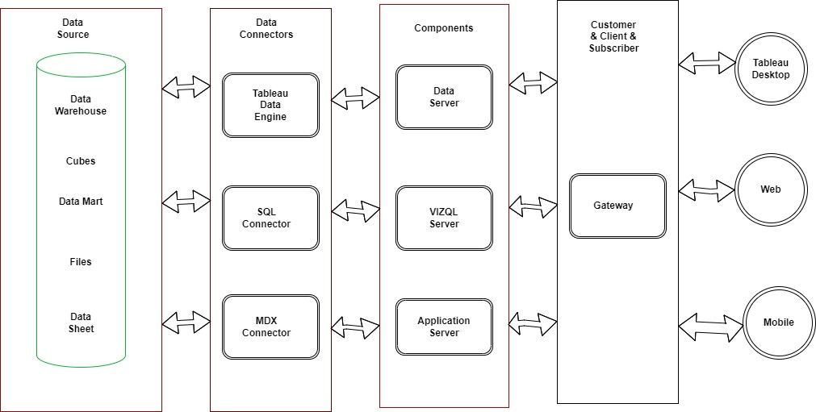
SYSTEM DESIGN

Slide 16
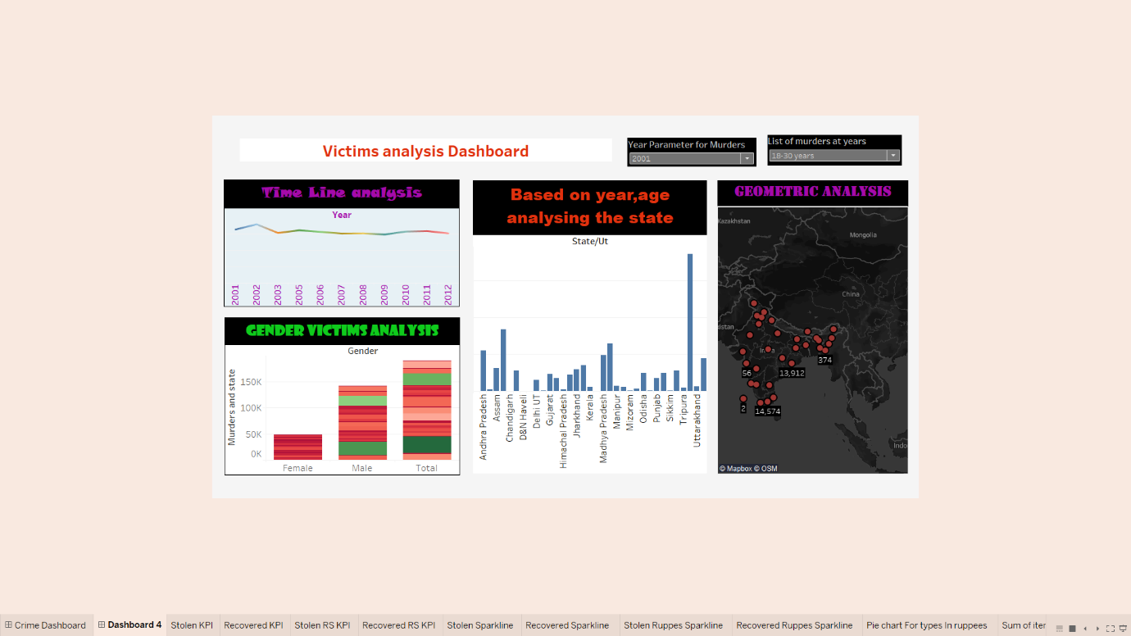
Output-Victim Analysis Dashboard

Slide 17
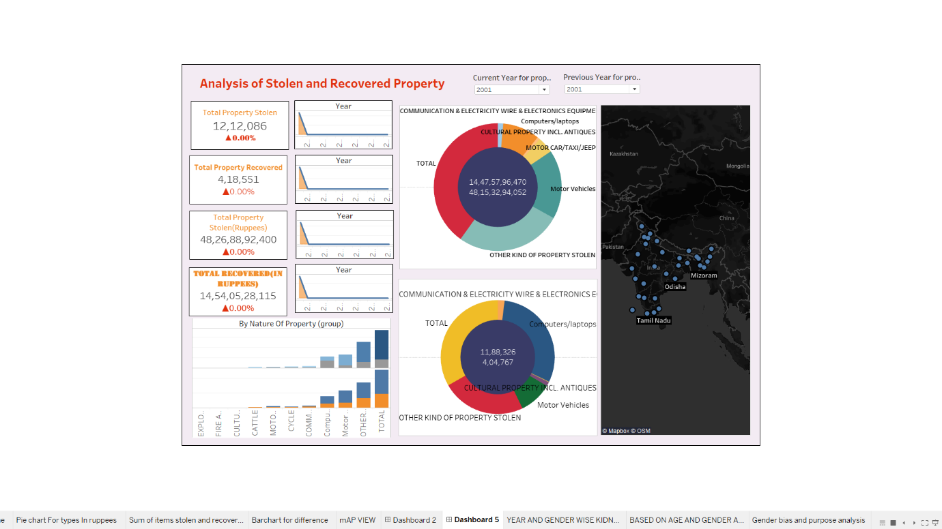
Output-Analysis of stolen and recovered property Dashboard

Slide 18
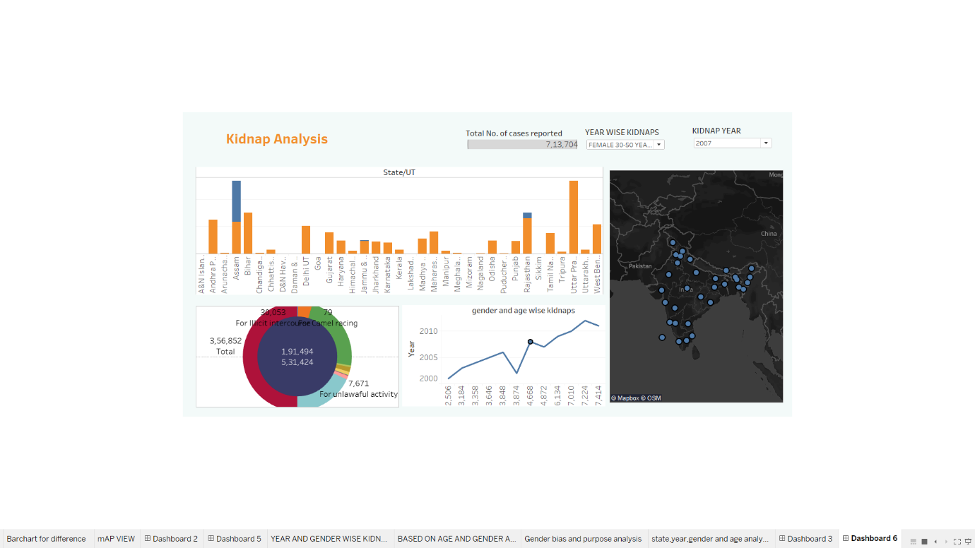
Output – Kidnap Analysis Dashboard

Slide 19
CONCLUSION
In conclusion, the Crime Data Analysis project aims to address the pressing issue of crime by harnessing the power of Tableau to provide actionable insights and inform decision-making among stakeholders. The project focuses on analyzing real-time crime data, including kidnap cases, murder cases, and property stolen and recovered cases, from various sources to uncover patterns and trends. Through interactive dashboards and visualizations, decision-makers can gain a deeper understanding of crime patterns, enabling them to allocate resources effectively and implement targeted interventions for crime prevention and public safety enhancement.
The project's scope encompasses the aggregation and visualization of crime data from different states, providing insights into crime patterns across various demographic groups. By leveraging Tableau's dynamic visualization tools, stakeholders can explore crime data in an intuitive and visually engaging manner, facilitating informed decision-making and strategic planning.

Slide 20
Future Scope
The future scope of your project encompasses a wide range of possibilities for expanding and enhancing the existing system to meet evolving needs and address emerging challenges. Here are several potential avenues for future development and growth:
Advanced Analytics Integration: Incorporate advanced analytics techniques such as machine learning, predictive modelling, and natural language processing into the Tableau environment. This would enable the system to generate more accurate predictions, identify complex patterns, and derive deeper insights from the data.
Enhanced Data Visualization: Explore opportunities to enhance the visualizations and dashboards within Tableau to provide users with more interactive, customizable, and immersive data exploration experiences. This could involve leveraging advanced visualization techniques, incorporating custom visuals and templates, and optimizing the user interface for enhanced usability and accessibility.
Employee Engagement and Feedback Analysis: Extend the scope of the project to include analysis of employee engagement surveys, feedback mechanisms, and sentiment analysis. By capturing and analysing qualitative data related to employee satisfaction, morale, and feedback, organizations can gain valuable insights into factors influencing attrition and attendance rates

Slide 21
Reference Papers
Bandekar, Shraddha Ramdas, and C. Vijayalakshmi. "Design and analysis of machine learning algorithms for the reduction of crime rates in India." Procedia Computer Science 172 (2020): 122-127Ranjan, Jayanthi, D. P. Goyal, and S. I. Ahson. "Data mining techniques for better decisions in human resource management systems." International Journal of Business Information Systems 3.5 (2008): 464-481.
Mungekar, D., Joshi, H., Kankekar, A., Nair, P., & Das, P. (2021, September). Crime analysis using dbscan algorithm. In 2021 Third International Conference on Inventive Research in Computing Applications (ICIRCA) (pp. 628-635). IEEE.Saxena, Mansi, Teena Bagga, and Sangeeta Gupta. "Fearless path for human resource personnel’s through analytics: a study of recent tools and techniques of human resource analytics and its implication." International Journal of Information Technology 13.4 (2021): 1649-1657..
Obagbuwa, Ibidun Christiana, and Ademola P. Abidoye. "South Africa crime visualization, trends analysis, and prediction using machine learning linear regression technique." Applied Computational Intelligence and Soft Computing 2021 (2021): 1-14.
McClendon, Lawrence, and Natarajan Meghanathan. "Using machine learning algorithms to analyze crime data." Machine Learning and Applications: An International Journal (MLAIJ) 2.1 (2015): 1-12.

Slide 22
Real world Crime Data Analysis and Visualization using Tableau(Loom)
Execution Link

Slide 23


